Slide 1
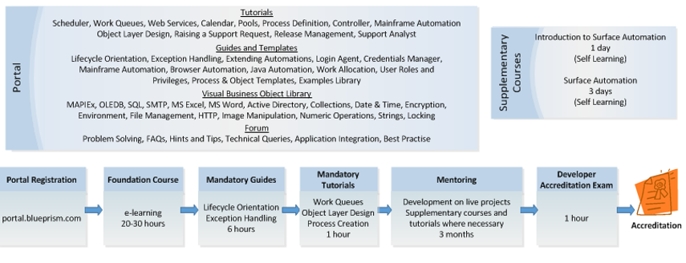
Blue Prism Developer Certification

Slide 2
Highlights
Need to register on Portal and complete 36 hours of online material.
Generally 3 Months of practical hands of experience is required to clear the Exam.
This 3 month duration not fixed and is relative to resource expertise on Blue Prism.
Once resource has expertise he can appear for online objective “Developer Accreditation Exam”
This exam like any other certification exam is multiple choice scenario based questions.
There is no trail exam available which resources can appear to check their competency.
However resources failing to clear the exam can appear again for this exam after one month.
Resources can repeat this process multiple times.
There is no Cost associated with certification.
Surface Automation related questions are not part of this Accreditation Exam.

